Slide 1
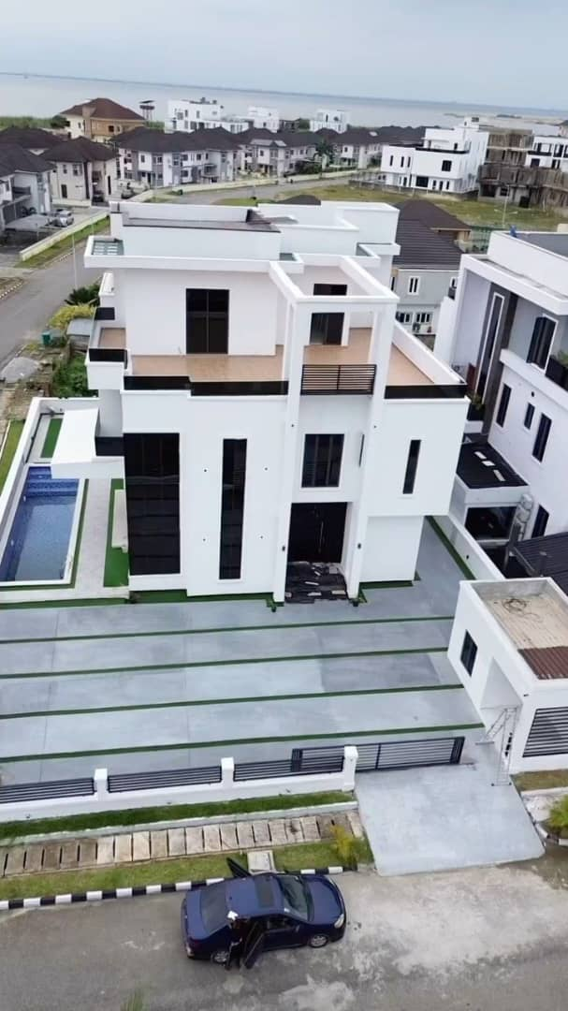
ANALYSIS OF HOUSING PRICES IN LAGOS
GROUP 4 NOVEMBER, 2024

Slide 2
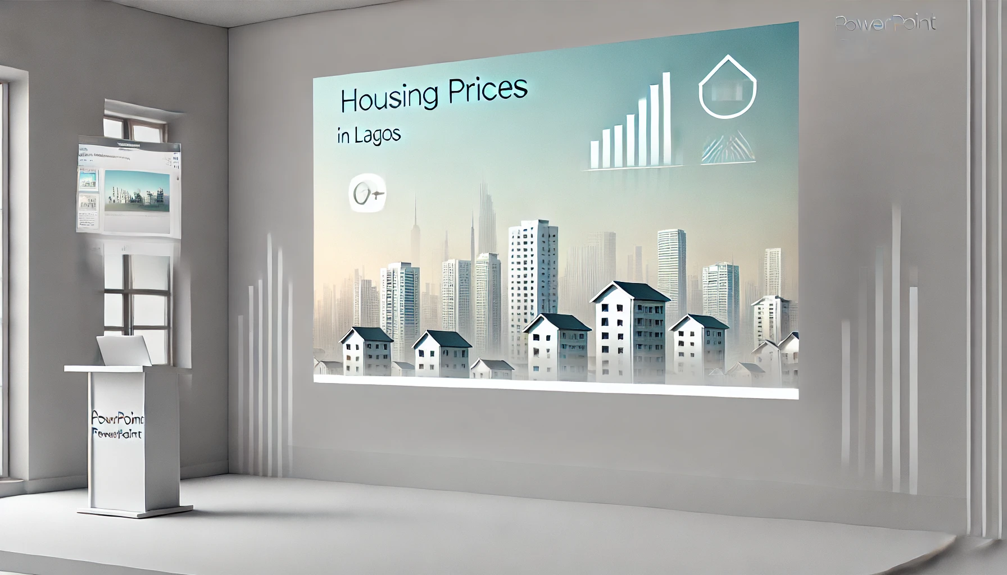
GROUP MEMBERS
1. Ayomide ADU - GROUP LEADER
2. Quareeb KAKO
3. Omowonuola FAGBEMI
4. Barakat KAMALDEEN
5. Rosemary Akuchi OSUJI
6. Daniel ALONGE

Slide 3
What’s The Problem?
Housing in Lagos is really, really, really, really, really expensive.
This analysis aims to find mitigation points around the expensive housing in Lagos.
Here’s what we mean.......

Slide 4
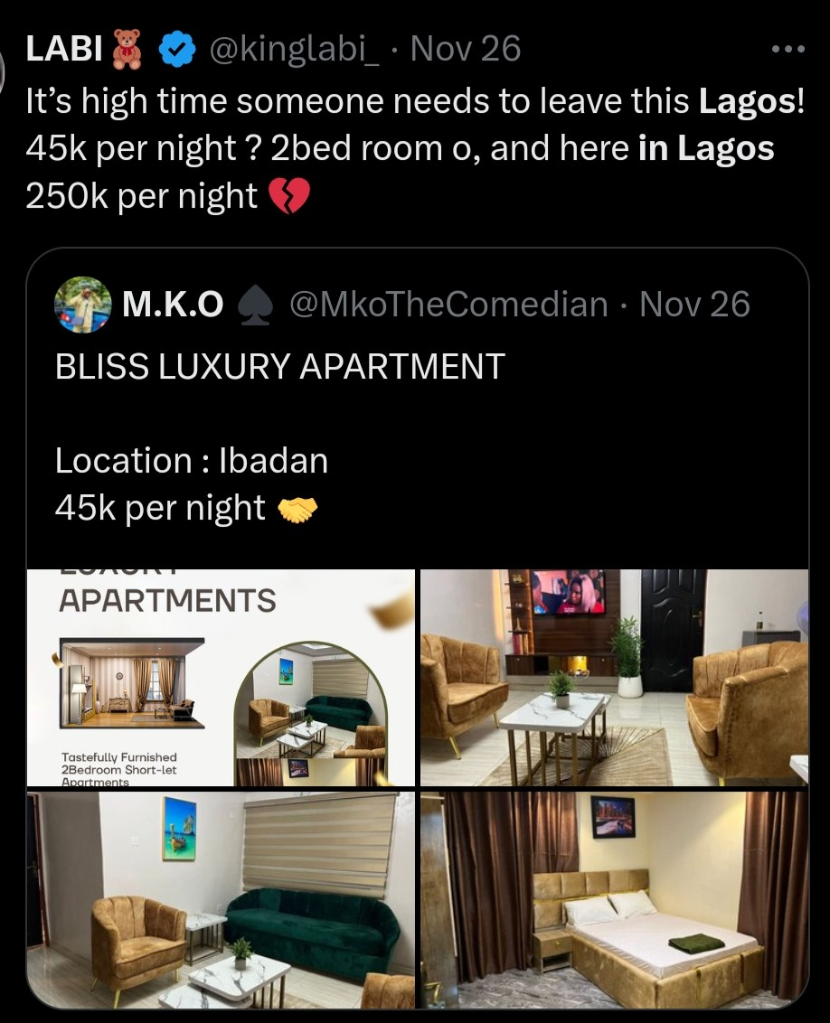
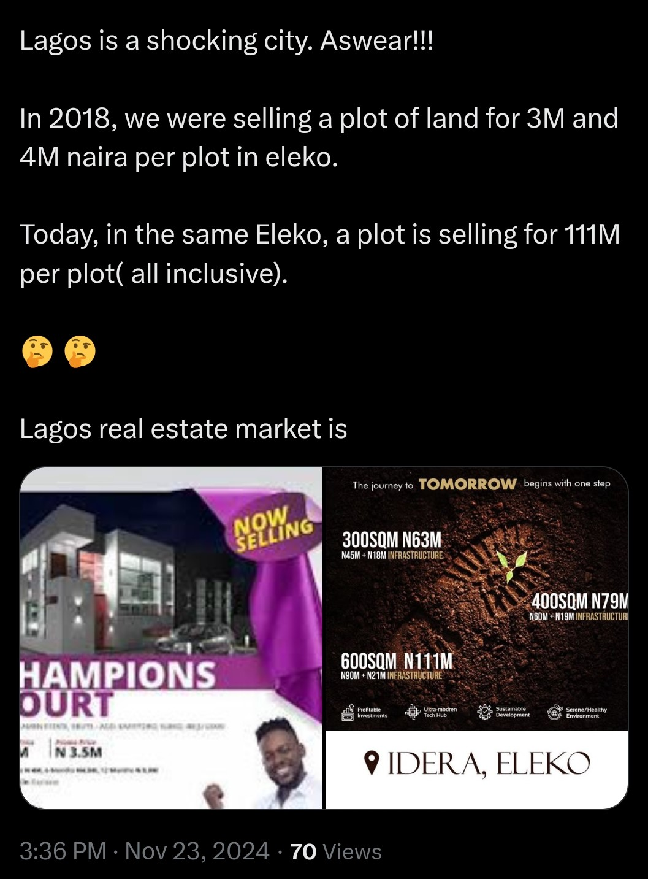
Living in Lagos: Between Smiles and Tears

Slide 5
From Bad to Worse: The Story Continues
Property prices in Lagos are expected to rise by about 5-10% in 2025.
Areas with a vibrant culture and modern amenities such as Victoria Island, Ikoyi and Eko Atlantic would particularly be affected (The African Investor, 2024).
Lagos possesses a housing deficit of 3 million units (The African Investor, 2024).

Slide 6
Why Are Lagos Homes Worth a Fortune?
Population Growth and Urbanization
Economic Conditions and Inflation
Infrastructural Development
Supply and Demand Imbalance (Ramos Real Estate, 2024).

Slide 7
Housing Analysis Overview
Used Excel for data cleaning and metrics calculation.
Created a Power BI dashboard for interactive visualizations.
Revealed regional trends, price ranges, and outliers.
Supported informed decision-making in real estate.

Slide 8
Summary of Analysis
Most Expensive Areas in Lagos
Most Affordable Areas in Lagos
Development Trends in Affordable Areas
Property Type Price Trends in Affordable Areas
Notes:
Highest Total Property Value:
Lekki leads with a total property value of ₦6,371,792,500.00, followed by Ikoyi with ₦6,133,482,000.00
Average Property Price:
Ikoyi also has the highest average price per property at ₦11,131,546.28, which suggests a premium real estate market.
Alimosho has the lowest average price per property at ₦579,870.69.
Most Listings:
Lekki has the most listings with 1,714 properties, indicating a highly active real estate market in that area.
Epe and Ijora have only 1 listing each, showing low property activity.
4. Market Distribution:
Areas like Ikeja (794 listings) and Yaba (1,130 listings) show a well-distributed property market, while other areas like Badagry and Obalende have limited listings, indicating either less activity or fewer available properties.

Slide 9
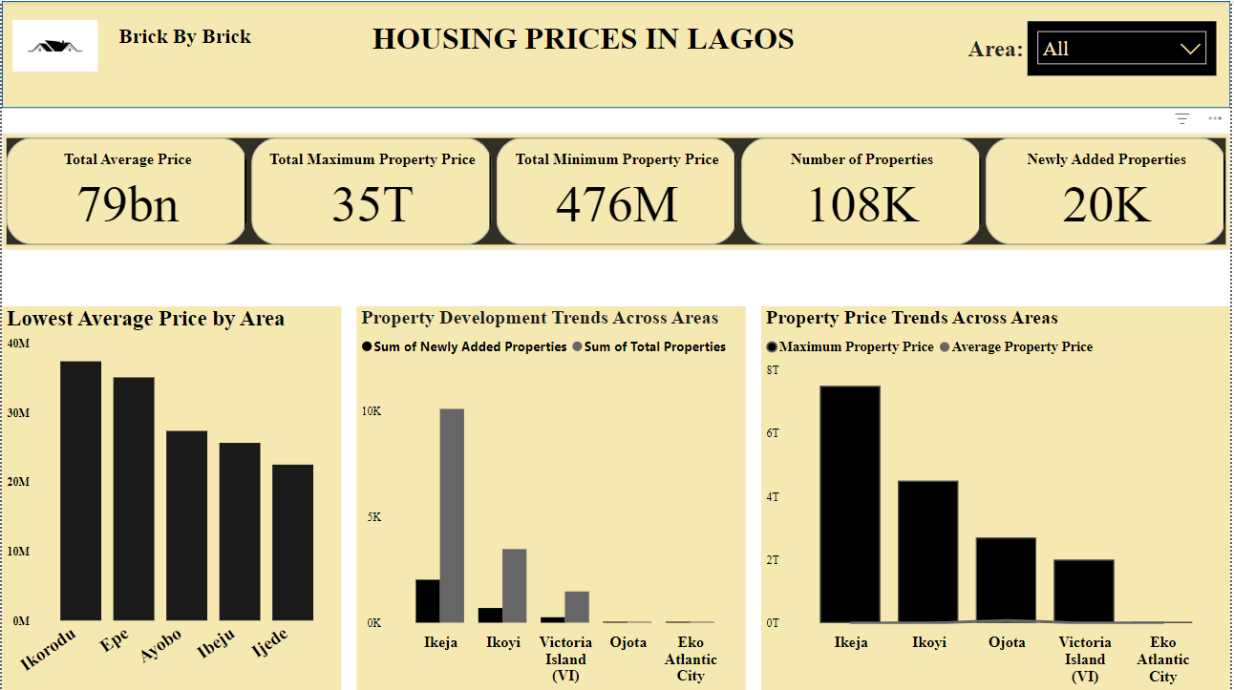

Slide 10
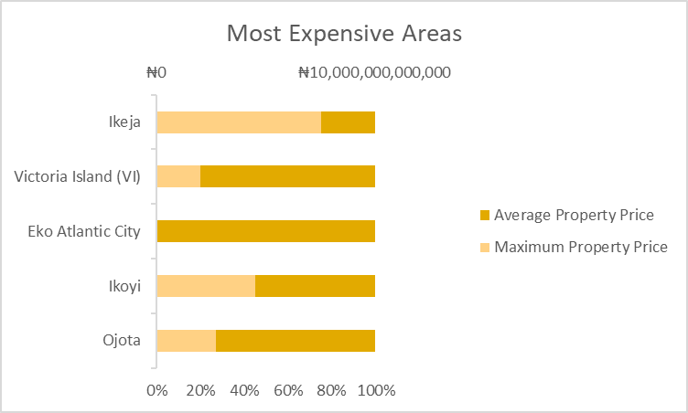
What are the most expensive areas in Lagos?

Slide 11
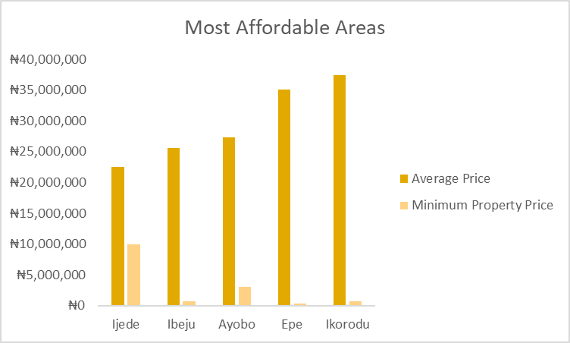
What are the most affordable areas in Lagos?

Slide 12
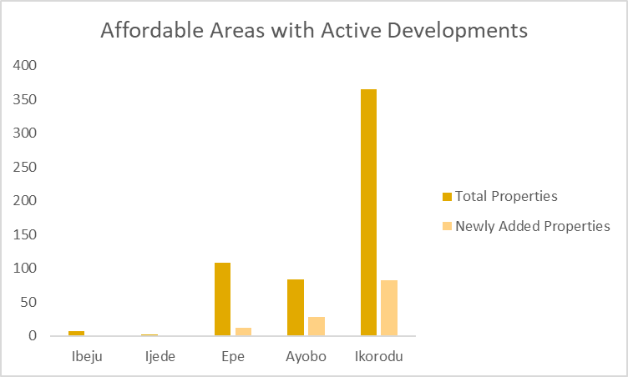
Key Development Trends Shaping Affordable Areas

Slide 13
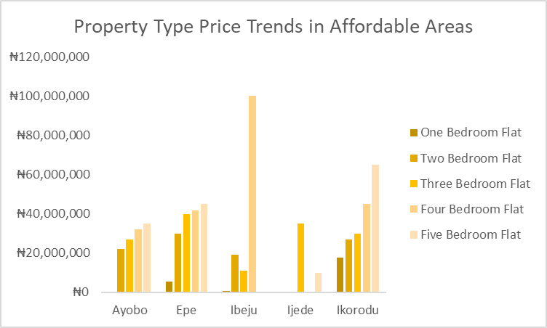
How Do Property Prices Vary By Type In Affordable Areas?

Slide 14
Recommendations
Increased Housing Supply
Infrastructural Development
Affordable Housing Schemes
Streamline Land Use Regulations

Slide 15
Conclusion
Analyzed Lagos housing prices to gain insights into the real estate market.
Used Excel for data preprocessing and Power BI for advanced visualizations.
Identified regional pricing variations and areas with highest/lowest average costs.
Highlighted the value of data-driven approaches in understanding market dynamics.
Showcased the power of analytical tools to transform data into actionable insights.

Slide 16
References
https://theafricanvestor.com/blogs/news/lagos-nigeria-price-forecasts. Accessed on 28/11/2024.
Ramos Real Estate (2024). Factors Affecting Home Prices in Lagos, Nigeria in 2024: Rental and Sales Properties.
27th Development Group
Nigeria Property Centre (2024). Average Prices of Houses For Sale in Lagos.

Slide 17
THANK YOU!

